Slide 1
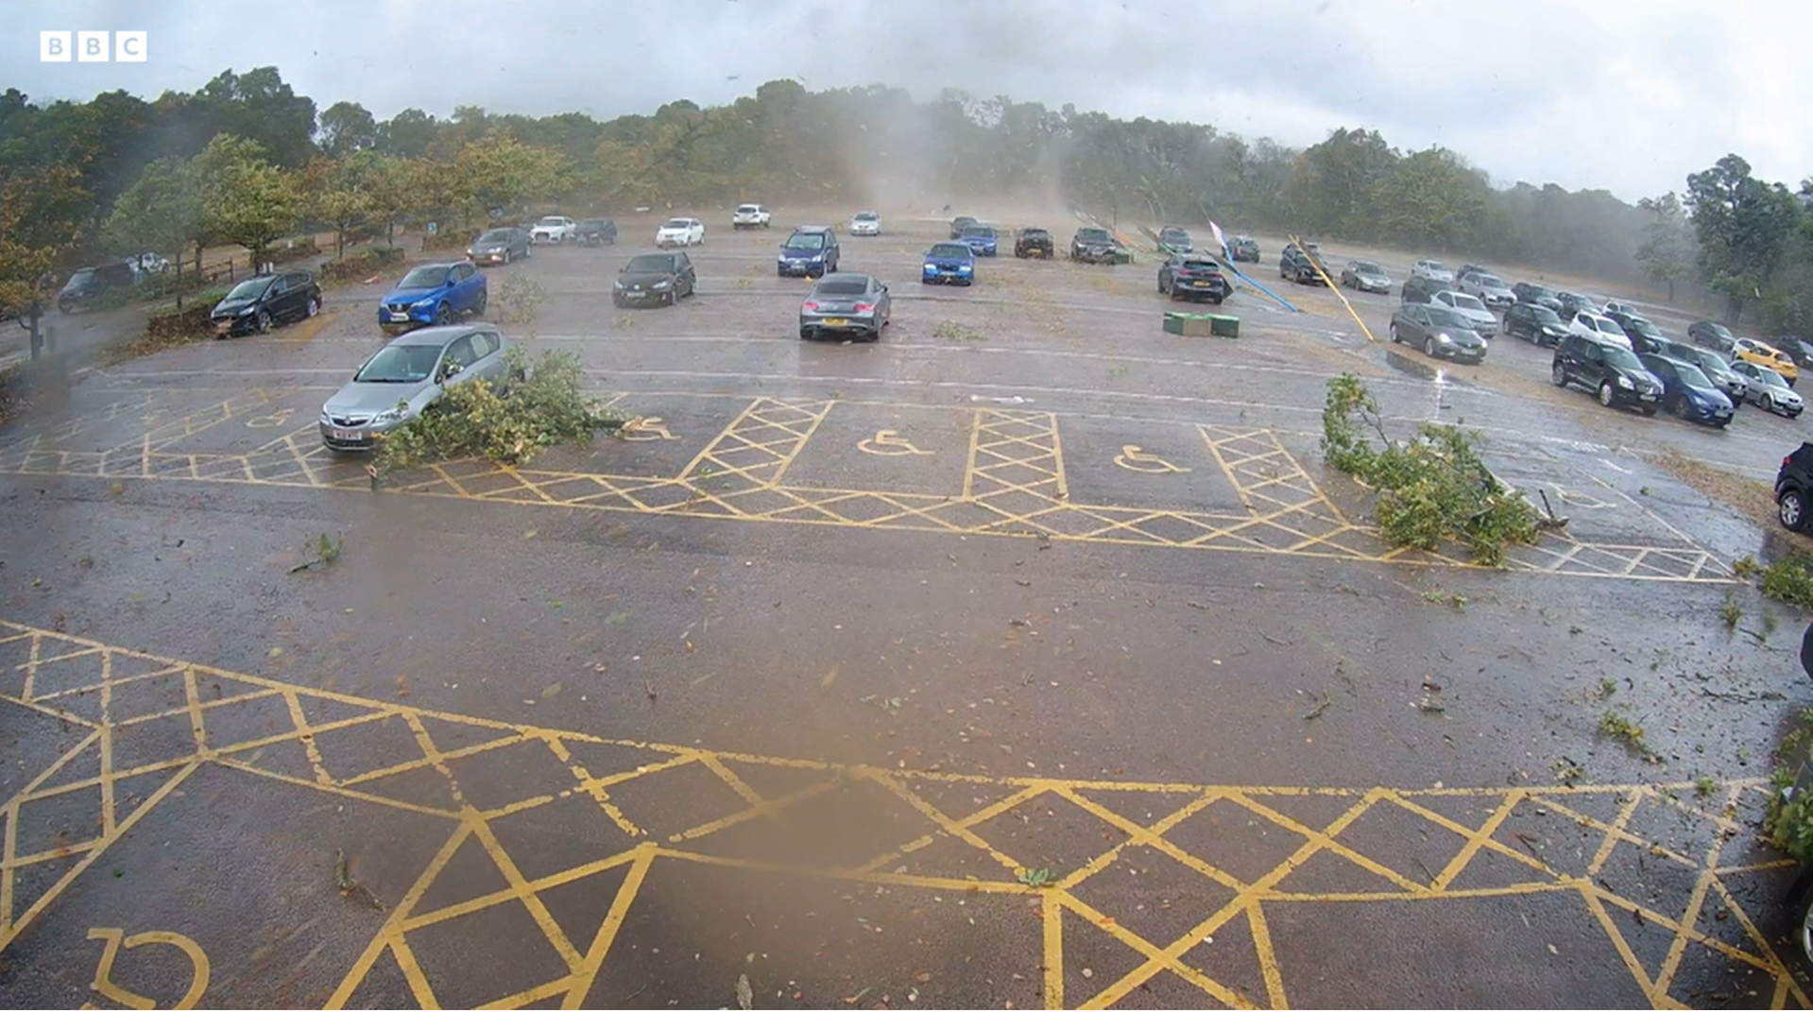
Dorset-Hampshire-Sussex Bow Echo and Supercell
Tornado captured on CCTV at Marwell Zoo in Hampshire (approximate time 1515 UTC): https://www.bbc.com/news/
uk-england-hampshire-63376546?fbclid=IwAR330hm5J5D8MvY6-v9ev95Px5jKcC8sUdE4lYYjgjnr6q2kMdPPS1TNnvU

Slide 2
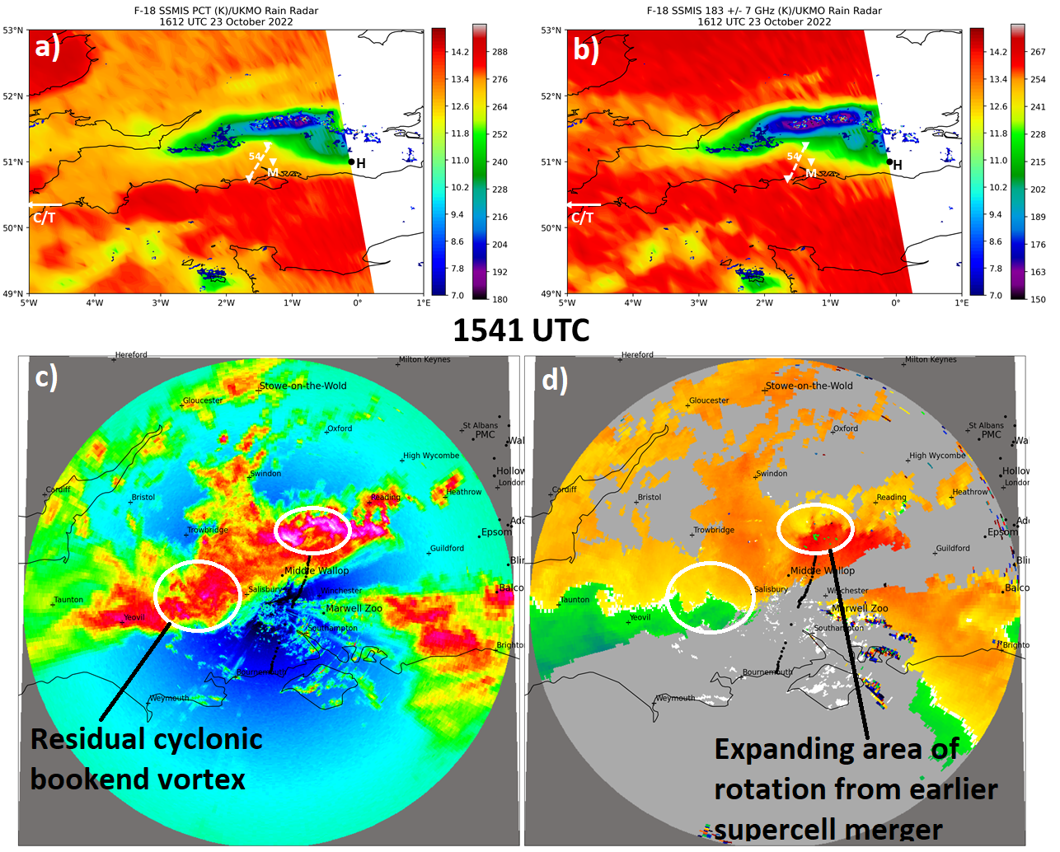
F-18 SSMIS polarization-corrected
temperature (PCT, K) and 183 +/- 7
GHz brightness temperature with
overlying UKMO radar rain rate. Dual-
polarized 91 GHz brightness
temperature datasets allow for
calculating polarization-corrected
Temperature.
Dean Hill, Wiltshire, Doppler radar
reflectivity and velocity.
SSMIS and Doppler radar datasets
are employed to extract the most
important patterns related to severe
convection, downburst, and tornado
occurrence. Comparison of passive
(SSMIS) and active (radar) microwave
imagery reveal storm physical and
dynamic forcing factors that promote
intense downdraft and outflow wind
generation and, in some cases,
tornadogenesis.
Notes:
F-18 SSMIS a) polarization-corrected temperature (PCT, K) and b) 183 +/- 7
GHz brightness temperature with overlying UKMO radar rain rate at
1612 UTC 23 October 2022. Dean Hill, Wiltshire, UK Doppler radar
c) reflectivity and d) velocity at 1541 UTC 23 October 2022. “C/T” denotes
RAOB and NUCAPS sounding retrieval locations at Camborne and Truro,
Cornwall, respectively in a) and b). “H” marks the NUCAPS sounding retrieval
location at Haywards Heath, West Sussex.

Slide 3
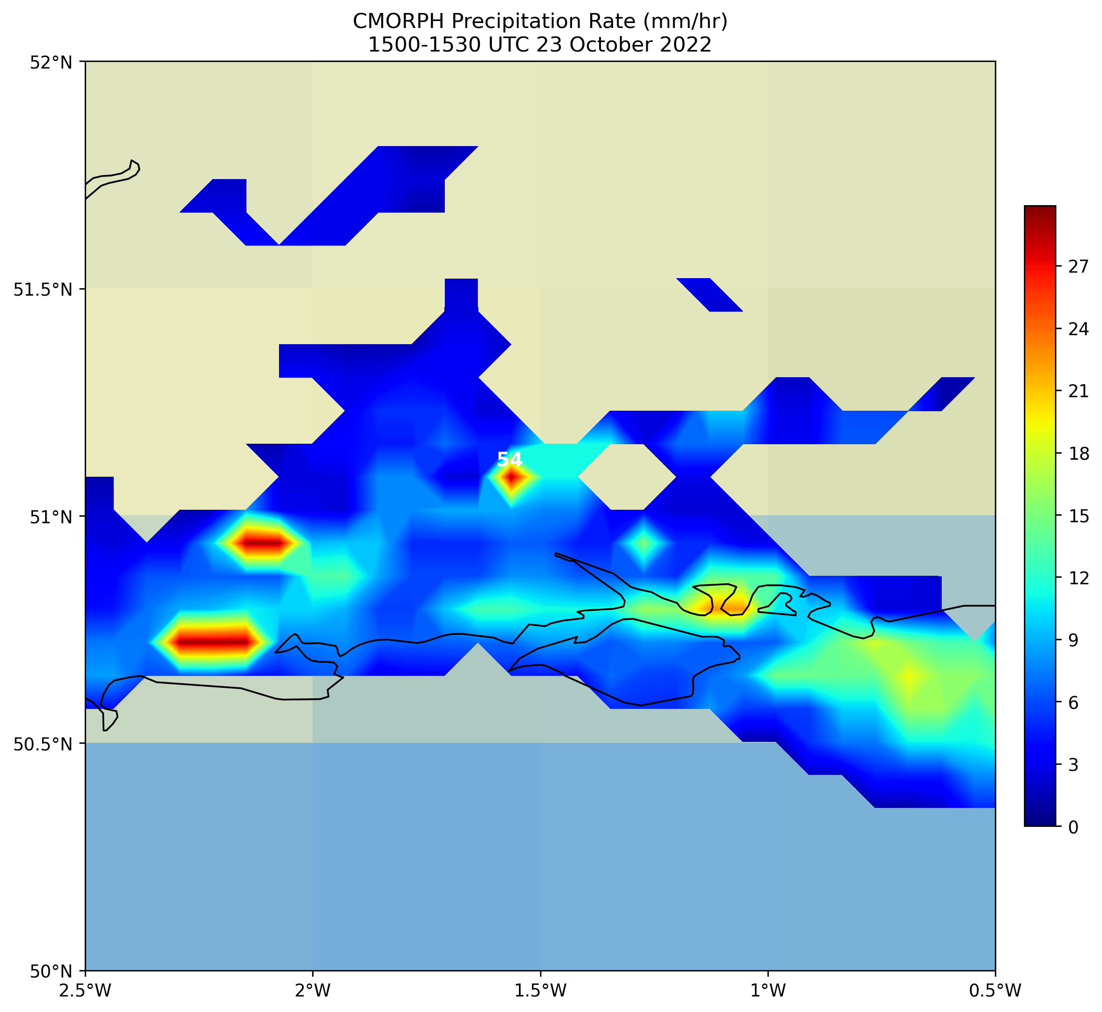
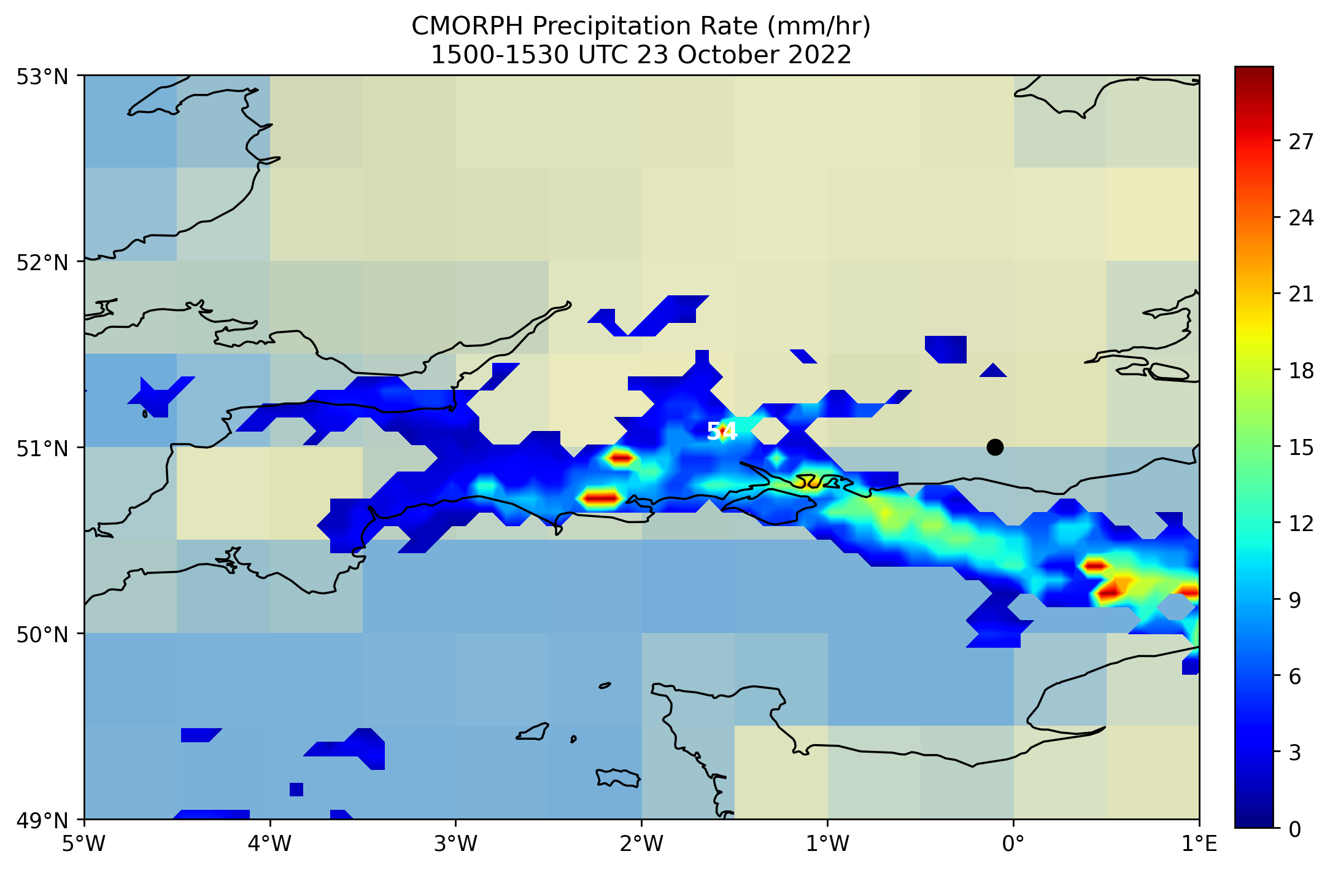
Satellite Passive MW-derived Rainfall Rate
a)
b)
H
National Weather Service Climate Prediction Center morphing technique (CMORPH)
precipitation rate datasets were obtained and visualized to evaluate the overall morphology and intensity of the MCS.
Notes:
A new technique is presented in which half-hourly global precipitation estimates derived from passive microwave satellite scans are propagated by motion vectors derived from geostationary satellite infrared data. The Climate Prediction Center morphing method (CMORPH) uses motion vectors derived from half-hourly interval geostationary satellite IR imagery to propagate the relatively high quality precipitation estimates derived from passive microwave data. In addition, the shape and intensity of the precipitation features are modified (morphed) during the time between microwave sensor scans by performing a time-weighted linear interpolation. This process yields spatially and temporally complete microwave-derived precipitation analyses, independent of the infrared temperature field. CMORPH showed substantial improvements over both simple averaging of the microwave estimates and over techniques that blend microwave and infrared information but that derive estimates of precipitation from infrared data when passive microwave information is unavailable. In particular, CMORPH outperforms these blended techniques in terms of daily spatial correlation with a validating rain gauge analysis over Australia by an average of 0.14, 0.27, 0.26, 0.22, and 0.20 for April, May, June–August, September, and October 2003, respectively. CMORPH also yields higher equitable threat scores over Australia for the same periods by an average of 0.11, 0.14, 0.13, 0.14, and 0.13. Over the United States for June–August, September, and October 2003, spatial correlation was higher for CMORPH relative to the average of the same techniques by an average of 0.10, 0.13, and 0.13, respectively, and equitable threat scores were higher by an average of 0.06, 0.09, and 0.10, respectively.

Slide 4
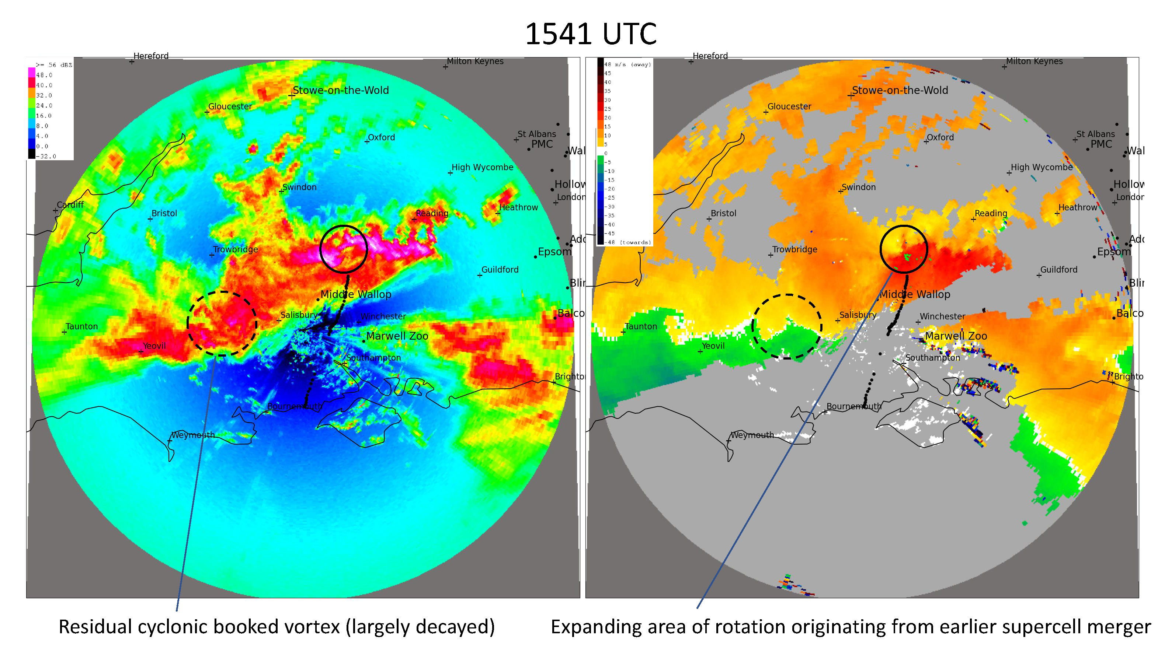
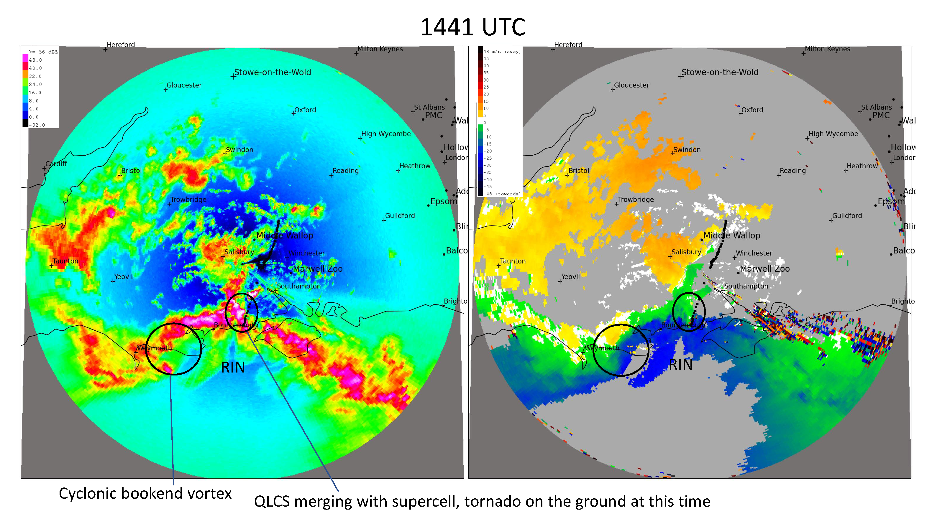
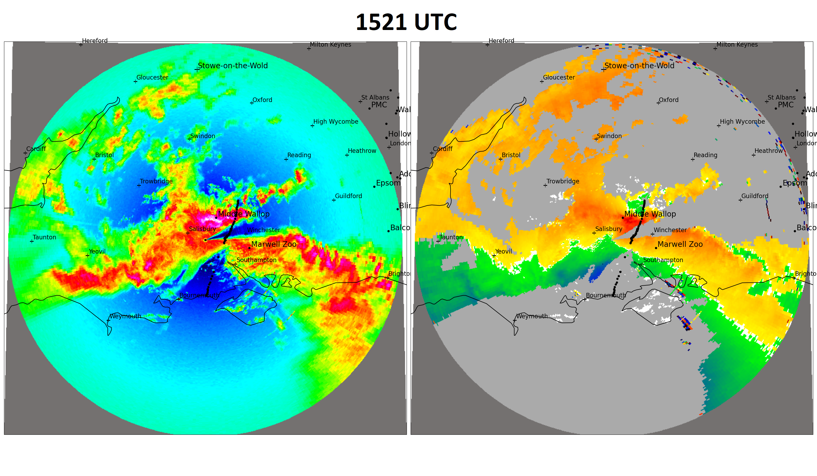
Courtesy of Matthew Clark, Met Office

Slide 5
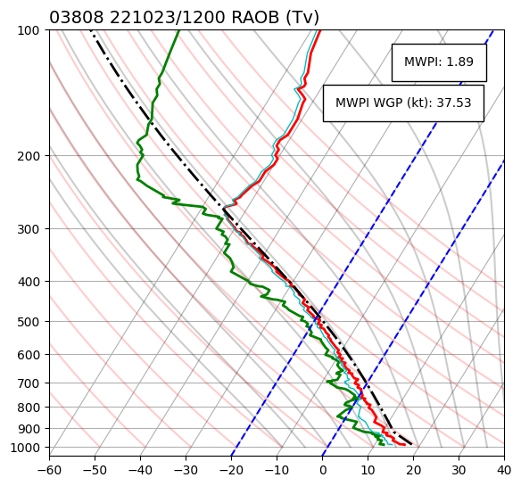
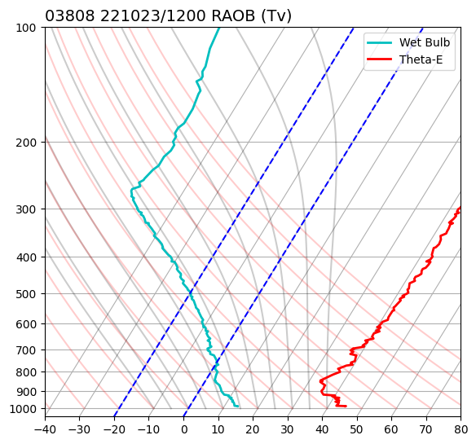
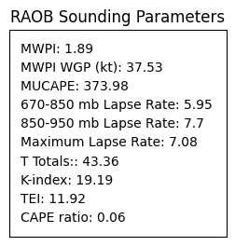
RAOB Sounding: Camborne, Cornwall, UK
c)
d)
WGP + 10 = 47.5 kt
Optimal for strong convective winds
LCL height = 582 m
Conditional/potential instability
Notes:
LCL height of 582 m is optimal for tornadogenesis: very low LCLs enhance tornado potential by limiting sub-cloud evaporation and decreasing the
potential for cold outflow that could interfere with the developing mesocyclone.

Slide 6
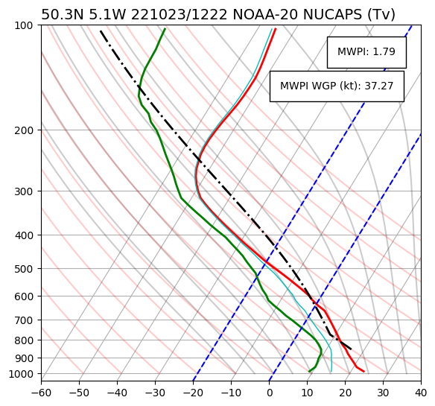
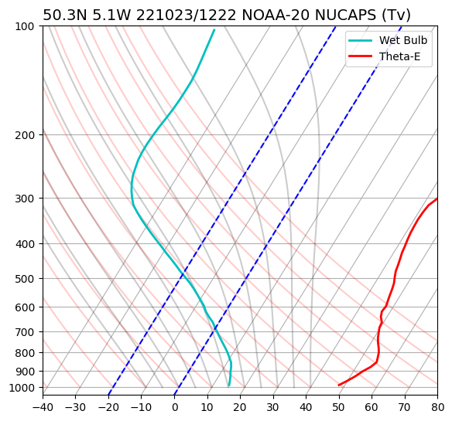
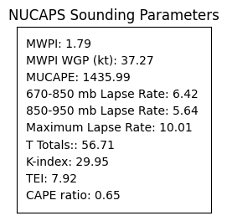
NOAA-20 NUCAPS: Truro, Cornwall, UK
c)
d)
WGP + 10 = 47.3 kt
CI/PI
UL
WBZ
LCL height =2093 m
Optimal for strong convective winds

Slide 7
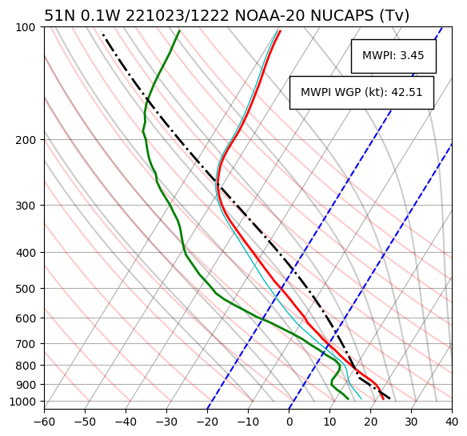
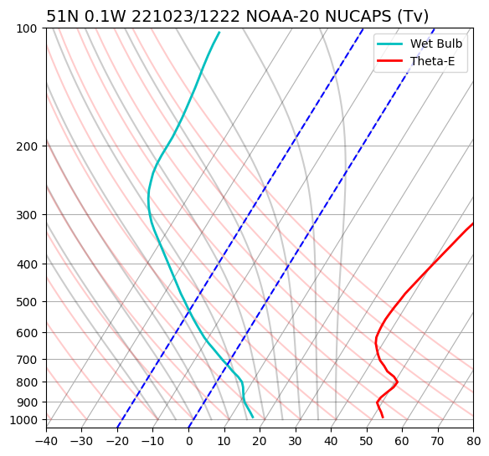
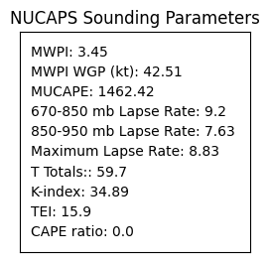
NOAA-20 NUCAPS: Haywards Heath, WS, UK
c)
d)
In general, the early afternoon (1222 UTC) NOAA-20 NUCAPS
soundings qualitatively indicated the strongest signal for severe thunderstorm, downburst occurrence over southern England:
Resolved a shallow elevated mixed-layer that was detected by the closest downstream RAOB sounding at Nottingham.
Indicated larger lower-middle tropospheric temperature lapse rates and CAPE than the adjacent AIRS sounding.
NUCAPS surface temperature (66°F/18°C) matched exactly the temperature recorded at Herstmonceux, the closest observing station to the retrieval.
WGP + 10 = 52.5 kt
Large CAPE
CI/PI
WBZ
LCL height = 1157 m
Optimal for strong convective winds

